Slide 1
2019 NGSS Assessment Results
CT Science Supervisors Association Meeting
October 2, 2019
Jeff Greig, CT State Department of Education
Jeff.Greig@ct.gov
Phone: 860-713-6854

Slide 2
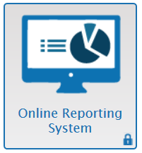
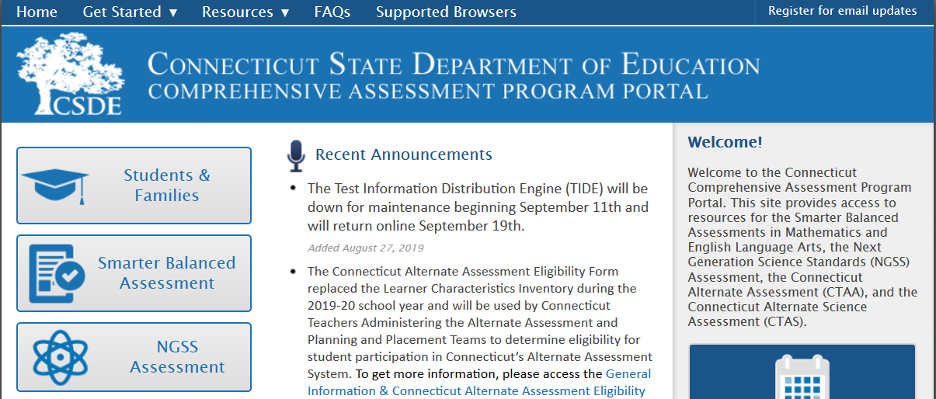
Secure 2019 NGSS Assessment results were released to local school districts on September 27
Available through AIR’s Online Reporting System (ORS) – access through assessment web portal:
https://ct.portal.airast.org
Access requires account in ORS

Slide 3
2019 NGSS Assessment Results
Individual student reports will be sent to districts on (or about) October 18.
Results will be released to the public later in the fall through http://edsight.ct.gov
Results will be included in district and school accountability:
Includes a broad set of 12 indicators
Science assessment results included in indicator 1: Academic Achievement
Next round of accountability reports will be available around December

Slide 4
https://portal.ct.gov/SDE
For the Next Generation Accountability System, results for the NGSS Assessment and CTAS Assessment will be transformed into a science performance index (similar to that for ELA and Math). This performance index will contribute to Indicator 1 of Connecticut’s Next Generation Accountability System starting with the 2018-19 accountability results. This indicator measures the achievement status of students in ELA, Mathematics, and Science. Pursuant to Connecticut’s approved ESSA plan, at the elementary and middle school levels, the science performance index will contribute 100 points (split evenly between all students and high needs students); for high schools, science will contribute 200 points while ELA and Math will contribute 300 points each (again split evenly between all students and high needs students).
For questions regarding the accountability system, please contact Renee Savoie at renee.savoie@ct.gov.

Slide 5
2019 NGSS Assessment Results
Results available for students, schools, districts and the state:
Overall Science: Scale Scores and four Performance Levels
Three-dimensional Disciplines (Life, Physical and Earth/Space Sciences):
Average scale score
Relative to proficiency standard (Below, Approaching, Above)
Results available for groups of students only:
11 Disciplinary Core Ideas:
Relative strengths and weaknesses
Relative to proficiency standard
Grade | Scale Score Range | Does Not Meet | Approaching | Meets | Exceeds
5 | 400 - 599 | 400 - 467 | 468 - 497 | 498 - 534 | 535 - 599
8 | 700 – 899 | 700 - 771 | 772 - 797 | 798 - 841 | 842 - 899
11 | 1000 - 1199 | 1000 - 1072 | 1073 - 1098 | 1099 - 1140 | 1141 - 1199

Slide 6
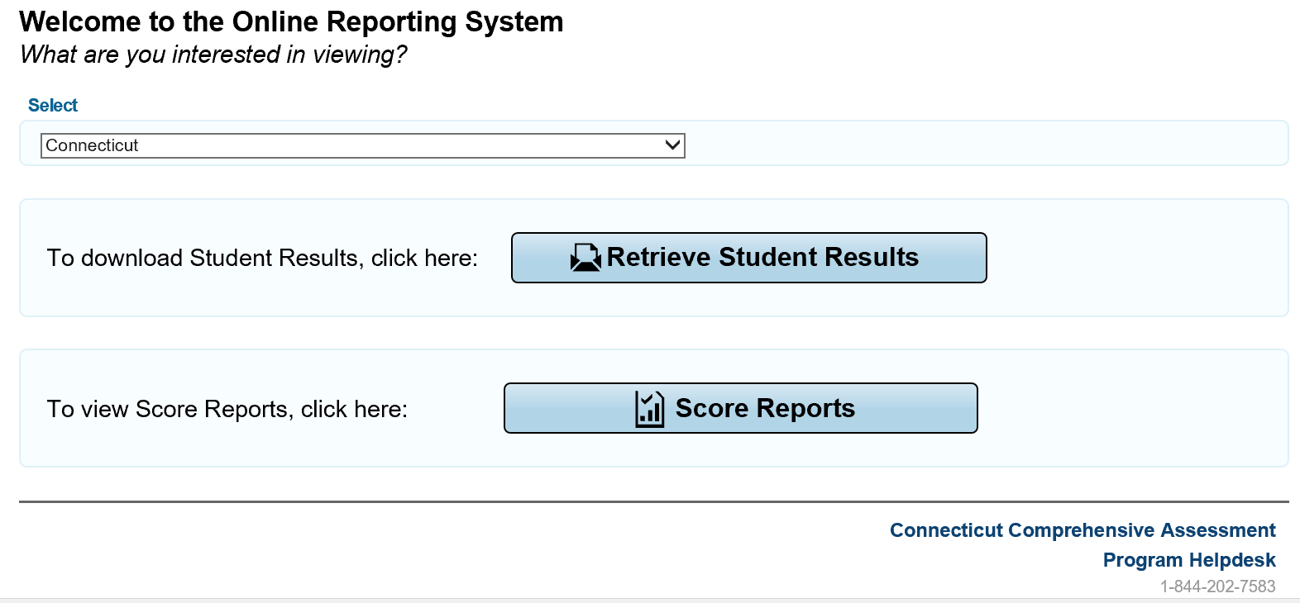
Export Excel files
Access online reports

Slide 7
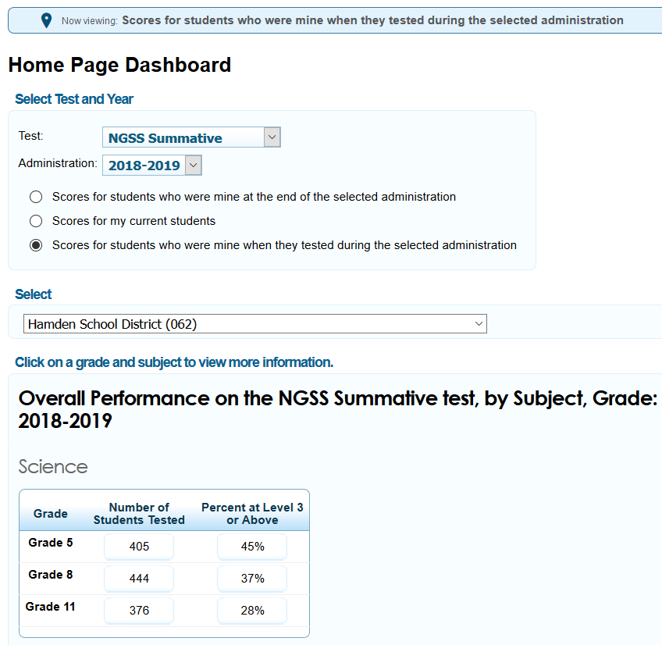
ORS Home Page
Demo Schools
Click on to access
grade level reports

Slide 8
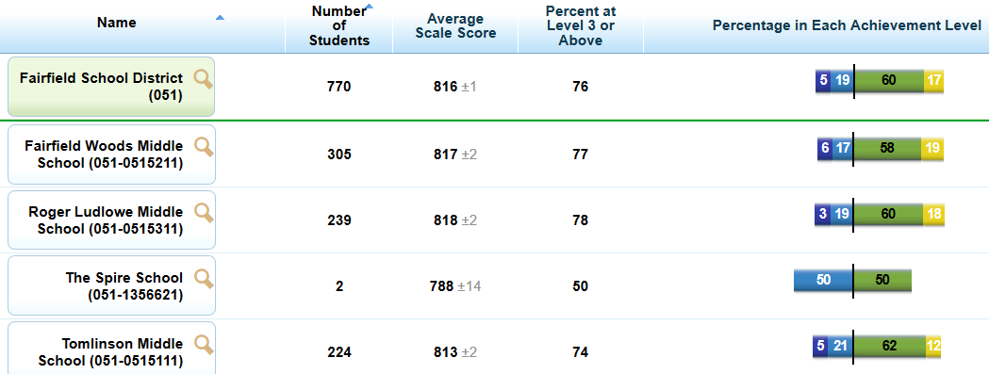
Overall Science Results by District and School
Demo District
Demo School 1
Demo School 2
Demo School 3
Demo School 4
Ethnicity/Race
Gender
IDEA Indicator
Limited English Proficiency Status
Click on the district or school to get more detailed reports (see next slide).

Slide 9
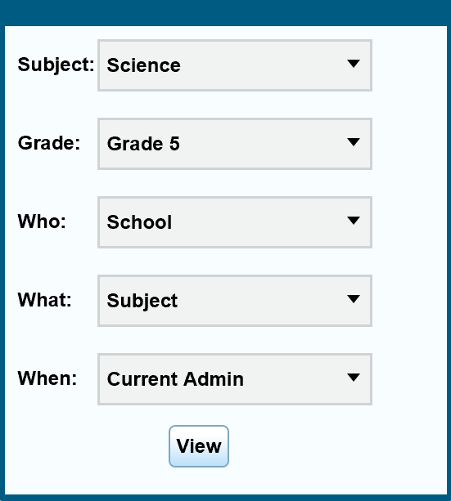
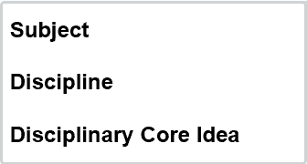

Slide 10
Discipline Results by District and School
Demo District
Demo School 1
Ethnicity/Race
Gender
IDEA Indicator
Limited English Proficiency Status

Slide 11
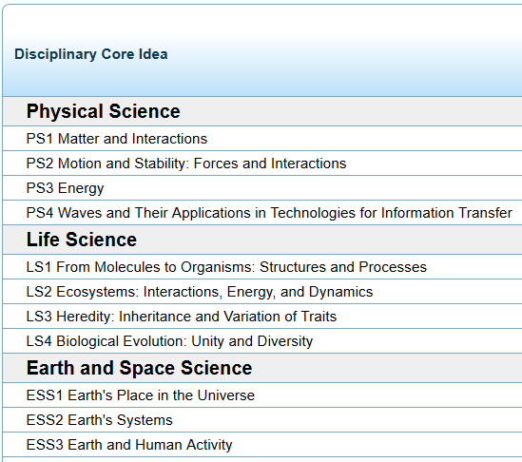
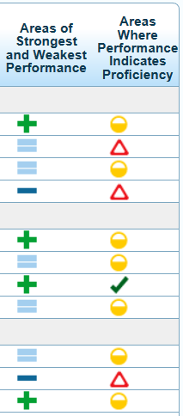
Disciplinary Core Ideas (DCI) Results by District and School
Note: Subgroup results are not available for DCI areas.
* Insufficient information results from too few students in a group or too few items in the test bank.

Slide 12
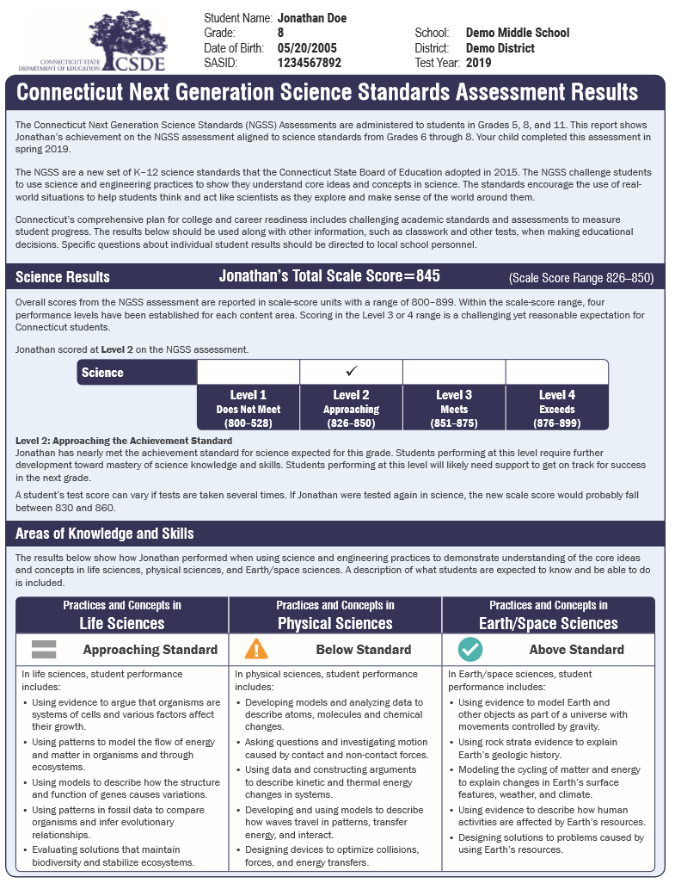
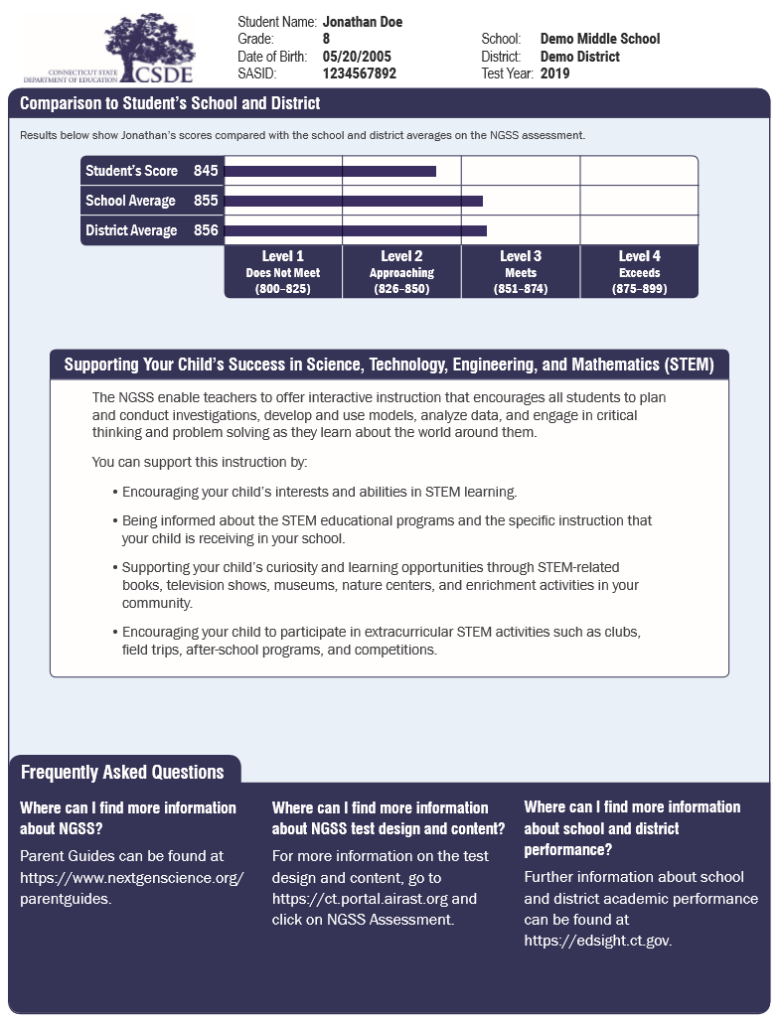
Sample Individual Student Report

Slide 13
Future of NGSS Assessments and Reporting
NGSS assessment will likely be adaptive starting in spring 2020. (Test was matrix sample design in 2019).
2020: May be able to report results by individual performance expectation (for groups of students)
2021: New reporting category claims based on practices and targets that include crosscutting concepts:
Gathering Data and Investigating Scientific Questions
Developing and Using Models to Describe the Natural World
Using Mathematical Thinking to Analyze and Interpret Patterns in Data
Use Scientific Reasoning to Construct Explanations and Arguments and to Design Solutions
DRAFT Claims

Slide 14
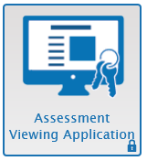
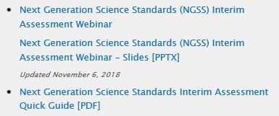
NGSS Interim Assessments
Will be available on October 15
Same item clusters as in 2019
(will be administered individually instead of in pairs)
Grade | No. of Item Clusters
3-5 | 14
6-8 | 20
High School | 20
Educators can access NGSS interims through Assessment Viewing Application
through the web portal: https://ct.portal.airast.org
Resources available:
Using NGSS Interim Assessments in the Classroom:
https://www.youtube.com/watch?v=nrp9bSf2L7E&t=8s

Slide 15
Questions
For information about NGSS Standards Implementation, Instruction, Curriculum Resources in Connecticut contact:
Ron Michaels
CT State Department of Education
Academic Office
860 713-6851
Ronald.Michaels@ct.gov
For information about NGSS Assessments (Standard, Alternate, Interims) in Connecticut contact:
Jeff Greig
CT State Department of Education
Performance Office
860 713-6854
Jeff.Greig@ct.gov

